Slide 1
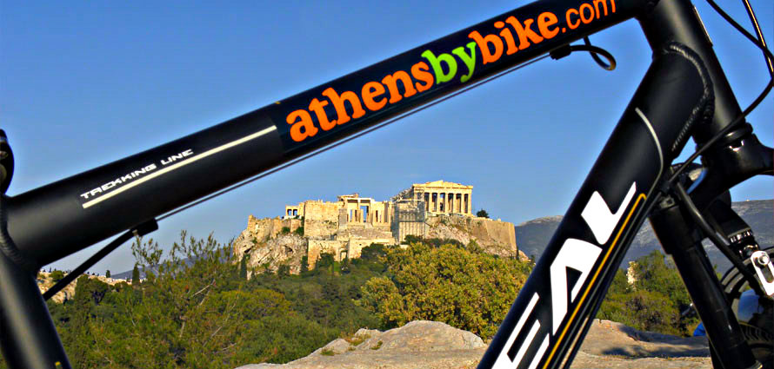
Bike Tours + Rentals
BIKE TOURS
2020-2021
"Athens by Bike"- Travel Agency
Gnto Licence : 0206E60000533501
www.athensbybike.com reservations@athensbybike.gr t. +30 216 900 3321

Slide 2
Athens by bike is a travel agency operating city bike tours. We have introduced a unique way of sightseeing in Athens which is a trend in most European cities. The idea to provide a safe, fun and unforgettable experience in the heart of the city center was born in 2004. Over the last years, we have shared our secret spots, our quirky 'inside’ information and stories with thousands of visitors with endless passion.
Since 2017 we are part of Cycle Cities, a global network of the best bike tour operators in the world. We are centrally located next to “Acropolis” metro station and we welcome our guests in two shops of 100 sqm.
We have designed a variety of bike tours, suitable for families, small groups, couples or solo travellers, offering a superior customer service for years. Our carefully crafted easy and safe routes cover the most interesting and vibrant parts of Athens, giving our guests a great overview of the city. Our goal is to make our bike tours the absolute highlight of their trip in Athens.
We also offer tailor made bike tours for groups of up to 60 participants.
Our bike tours are perfect half-day activities suitable for high-school, college & university students and an ideal environment-friendly team building activity for company incentives.
Our Services
Our Team
We have a professional team of experienced local urban bikers. All of them are fluent in English and well-trained to offer high quality services to our guests. We believe that our success is based on the choice of our team and we have set high recruitment standards.
Safety is our No 1 priority, therefore:
We limit the size of the group up to 12 participants per tour leader.
We design our bike tours on car-free zones, pedestrian areas and bike lanes.
We have a permanent staff of well-trained tour leaders.
We have a dedicated team for our daily bike maintenance.
We are constantly renewing our bike fleet.
We strongly suggest to our guests to wear a helmet during the tour, although it is not mandatory in Greece.
Safety First
Our tours are ranked among the top 25 activities in the world based on the Trip Advisor and the Get your guide 2019 awards.
We are rated as the #1 Outdoor activity in Athens on TripAdvisor for the last 7 years and we constantly achieve to be among the top 5 ‘Τhings to do in Athens’. We have offered genuine local experiences to thousands of visitors over the last few years and we have a 100% positive feedback.

Slide 3
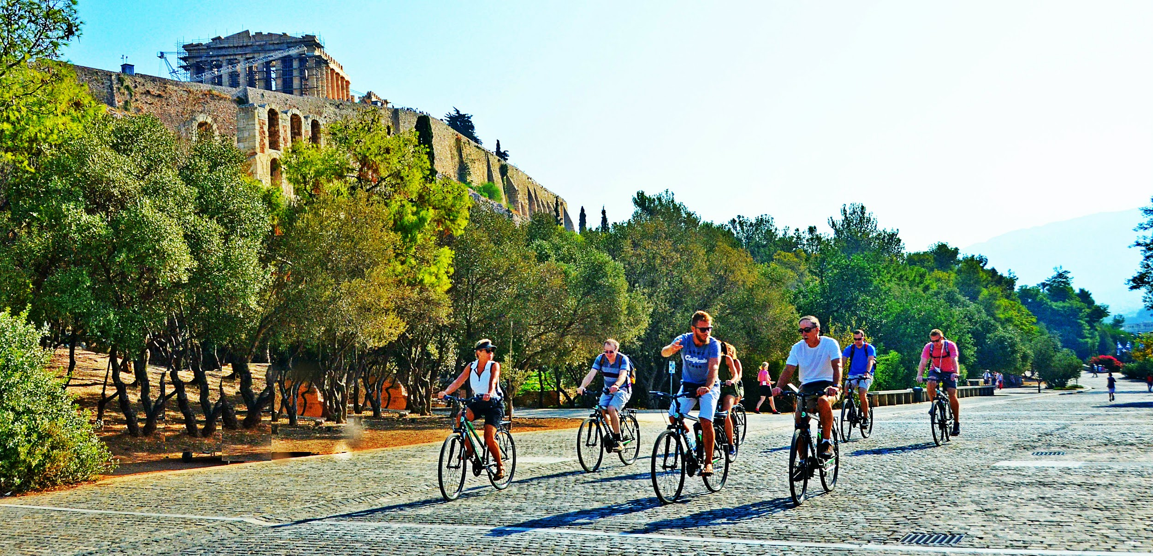
Athens Morning
Bike Tour
Duration: about 3.5 hours Distance: about 9 km Available in: English
The best outdoor activity in Athens
Have fun while cycling and uncovering the charms of Athens with our city bike tour! Ride around the historic center at a relaxed pace, using a safe traffic-free route.
You will get to know Athens from a different point of view, passing by all the must-see locations and many hidden spots. Our aim is to make your stay in Athens the most pleasant one. By the end of the tour you will be enlightened with a useful list of tips and suggestions about the city.
Highlights
Acropolis Museum, Acropolis panoramic view, National Observatory, Ancient Greek Cemetery of Kerameikos, Thission, Ancient Greek Agora, Roman Agora, Athens City Cathedral, Plaka neighborhood, National Gardens, Presidential Mansion, Panathenaic Stadium, Zappeion Exhibition Hall, Temple of Olympian Zeus, Hadrian’s Arch.
INCLUSIONS | INFO & PRICING
Tour leader Bikes and helmets Athens ’Things-to-do’ list Coffee break (Greek coffee or ice cream) Third party liability insurance | Starting time: 9:30 am Starting/Ending point: 16, Athanasiou Diakou str, Athens Days Offered: Daily, 365 days/year Team size: 1-12 pax. Minimum age: 12 y/o

Slide 4
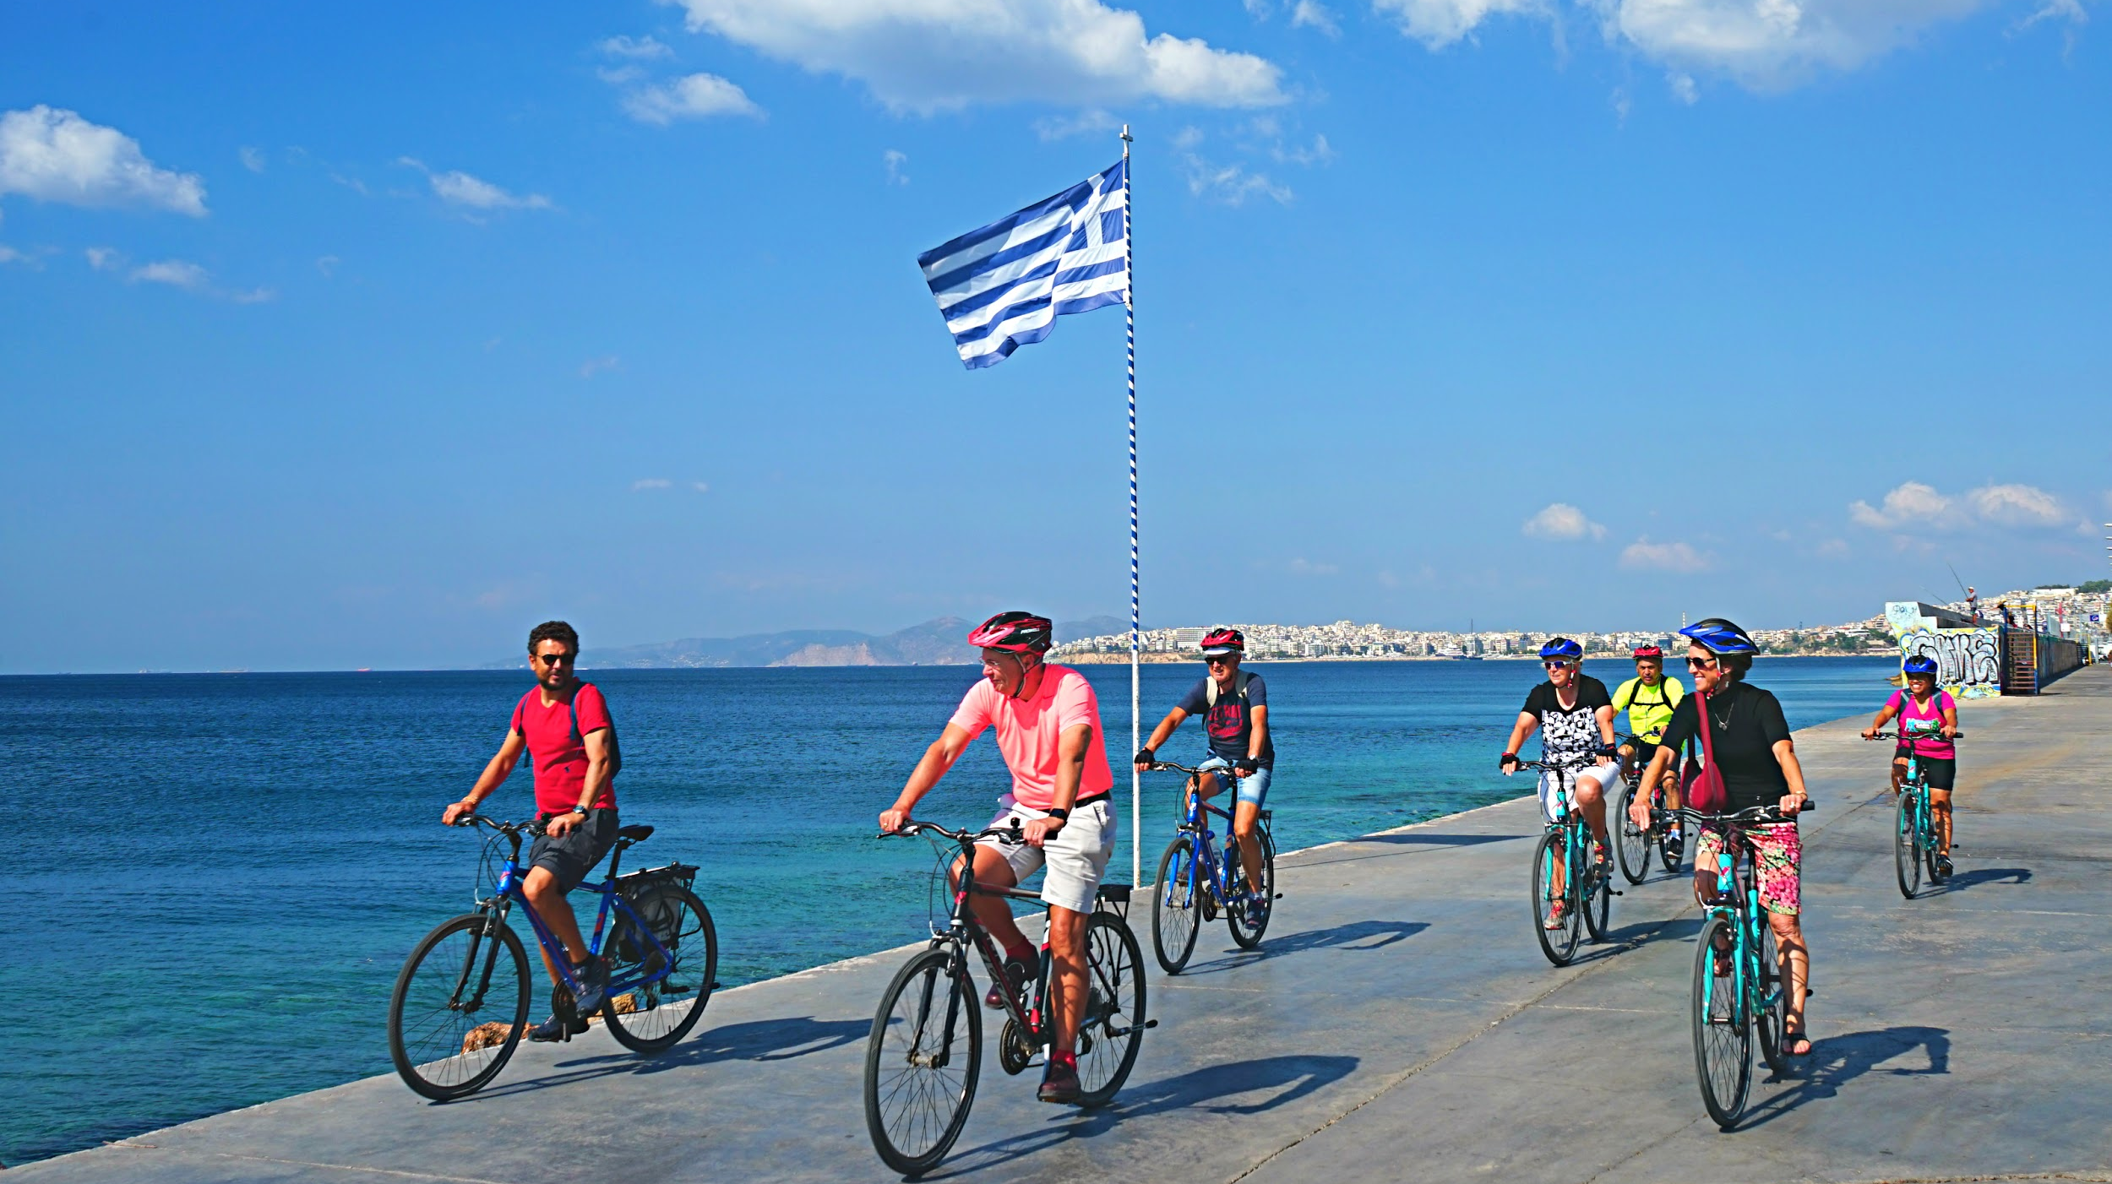
Athens Riviera
Bike Tour
Duration: about 4.5 hours Distance: about 28 km Available in: English
Athens sunshine & beach time!
Our ‘Athens Riviera’ bike tour is the perfect half-day activity in Athens! The city has the privilege of being next to a unique seaside resort with crystal clear blue water beaches, luxurious marinas, yacht clubs and numerous beach bars. Get some exercise while cycling through nice picturesque neighborhoods and explore an unseen urban side of the city. During summer and/or when weather permits, don’t forget to bring your swimsuit with you, as you can swim at a nice beach!
Highlights
Acropolis Museum, Acropolis hill, Roman Agora, Ancient Greek Cemetery (Kerameikos), Petralona neighborhood, Kallithea neighborhood, Moschato neighborhood, Greek National Opera House, New National Library, SNF Cultural Center, Taekwondo Olympic Stadium, Naval Museum, Flisvos Marina, Alimos Marina, Kalamaki Beach
INCLUSIONS | INFO & PRICING
Tour leader Bikes and helmets Athens ’Things-to-do’ list Local pastry tasting Third party liability insurance
Starting time:9:30am
Starting/Ending point: 16, Athanasiou Diakou str, Athens
Days Offered: Daily, 365 days/year Team size: 1-10 pax.
Minimum age: 12 y/o

